Slide 1
Fraud Detection Modeling
Thinkful Supervised Learning Capstone
Jonathan-Cassidy Ong

Slide 2
Overview

Slide 3
Background
Kaggle dataset: Synthetic Financial Datasets For Fraud Detection
Synthetic dataset used in financial analyses for fraud detection using Paysim
Fraud in the context of this project is defined as fraudulent mobile money transactions where an agent attempts to gain access to a customer's account and empty the funds by transferring to another account and cashing out of the system

Slide 4
How Important is Fraud Detection?
Mobile money transactions are quickly becoming the most widely used form of transactions
Venmo, Zelle, Apple Pay, Samsung Pay, Google Wallet, Ali Pay, Paypal, and the list goes on
If we make these forms of payment safer, usage and global acceptance of this practice would increase further
By creating an accurate classifier, we can further the growth of the mobile money transactions

Slide 5
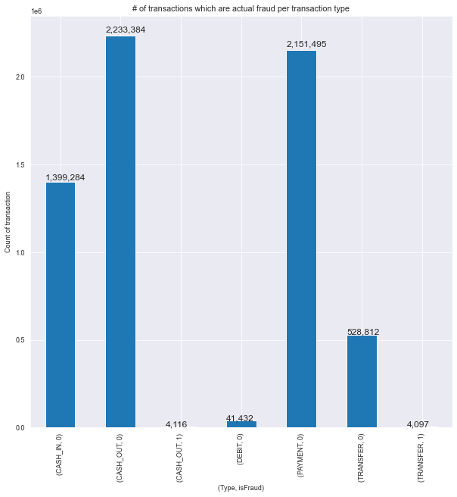
What are the chances?
With fraud, the ultimate goal is to TRANSFER and CASH OUT in order to successfully steal money
If this classifier is able to properly and accurately determine which transactions are fraud, then implementation of the classifier may be done to protect the targeted account

Slide 6
What do we want to accomplish?
Use the data to create a model with specifications that make it as fast and as accurate as possible. Speed isn’t always the most important factor, but in this case, I want to find the quickest, most accurate, and most practical application of this model, so speed will come into effect here.

Slide 7
Exploring the Data
There are 11 features in this particular dataset:
Continuous: Step (each step is 1 hour of time, totaling to 744 in our 30 day simulation), Old/New Balance Owner, amount, Old/New Balance Destination
Categorical: Type, nameOrig (customer who started the transaction), nameDest (recipient of the transaction), Fraud, Flagged as Fraud (isFlaggedFraud)
We will handle the categorical data by assigning dummies

Slide 8
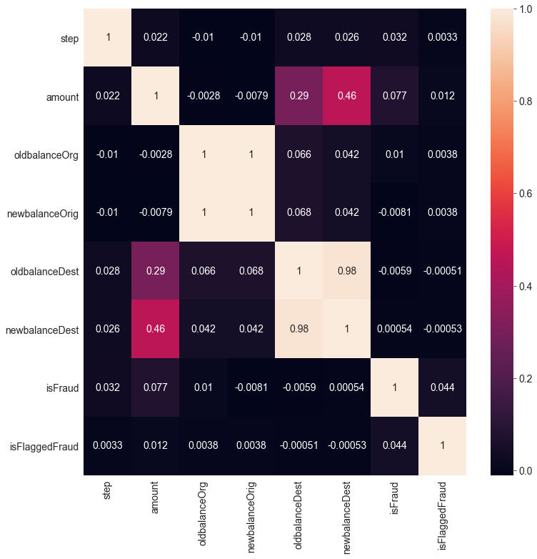
Correlation in the Dataset
Here we check if there’s too much multicollinearity between variables which would skew our results
Of the 6 million rows, we had 0 missing values and only 8,213 of those values were flagged as fraud

Slide 9
Resampling the Data
Because we have such a high disparity between fraudulent and non-fraudulent cases, any model we train would likely be 99% accurate when sampling from these values.
Instead, we will resample the data, allowing for us to see the actual effect of the model on the data
100,000 cases each of True and False for fraudulent transactions

Slide 10
The Methods
We have two main methods in which we will be selecting features
SelectKBest
SKB will remove everything except for highest scoring features, scored by the f-test to determine if there are any statistical significance in the variance of any possible features
Principal Component Analysis
PCA uses all the features to transform into brand new features that are completely independent from one another
Most variance was explained with up to 4 or 5 components, so we chose to have 4

Slide 11
Performance Expectations
Find the best parameters with the best classifying score using Grid Search CV
Average 5 Fold Cross Validation Score to resample data into 5 equal sized samples and running the model through each of them to determine average score
Classification Report (Average scores between the fraud and non-fraud cases)
Precision (TP/(TP+FP)) is the ability of the classifier to not label as positive a sample that is negative
Recall (TP/(TP+FN)) is the ability to find all the positive samples
F1 is the weighted average of the precision and recall, where an F1 scores reaches its best value at 1 and worst score at 0
AUC is the Area Under the Curve, which represents both high recall and high precision. In this case, the model has both a low false positive and false negative rates because of high precision and high recall, respectively

Slide 12
Model 1: Gaussian Naive Bayes
Gaussian model was chosen initially due to the presence of more continuous variables than categorical types. So the only way to incorporate the categorical was using the Gaussian model, unlike the Bernoulli and Multinomial NB.
SKB Results
Best Parameters: 3 Features
Avg. CV: 77.88% | | Avg. Precision: 85% | | Avg. Recall: 78%
Avg F1: 77% | | AUC: 15.21% | | Runtime: Fast
PCA Results:
Avg. CV: 83.63% | | Avg. Precision: 84% | | Avg. Recall: 84%
Avg. F1: 84% | | AUC: 39.57% | | Runtime: Fast

Slide 13
Model 2: KNN
To use SKB, the distance was normalized in features
SKB Results
Best Parameters: 8 Features, 2 Neighbors
Avg. CV: 99.35% | | Avg. Precision: 99% | | Avg. Recall: 99%
Avg F1: 99% | | AUC: 49.70% | | Runtime: Slow, ~2 Hours
PCA Results:
Best Parameters: 2 Neighbors
Avg. CV: 98.85% | | Avg. Precision: 84% | | Avg. Recall: 82%
Avg. F1: 82% | | AUC: 38.45% | | Runtime: Fast
Both models overfitted drastically. The overfitting did reduce very slightly with PCA, but not enough to matter

Slide 14
Model 3: Decision Tree
SKB Results
Best Parameters: 12 Features, 8 Max Depth
Avg. CV: 98.95% | | Avg. Precision: 99% | | Avg. Recall: 99%
Avg F1: 99% | | AUC: 48.70% | | Runtime: Fast, ~30 Seconds
PCA Results:
Best Parameters: 8 Max Depth
Avg. CV: 93.26% | | Avg. Precision: 87% | | Avg. Recall: 85%
Avg. F1: 85% | | AUC: 40.79% | | Runtime: Fast, 2 Seconds
Both models seem to do well, but the SKB model again seems overfitted probably due to high depth. The PCA looks slightly better

Slide 15
Model 4: Random Forest
SKB Results
Best Parameters: 9 Features, 50 Trees, 6 Max Depth
Avg. CV: 97.50% | | Avg. Precision: 97% | | Avg. Recall: 97%
Avg F1: 97% | | AUC: 47.49% | | Runtime: Slow, ~2 Hours
PCA Results:
Best Parameters: 10 Trees, 8 Max Depth
Avg. CV: 93.28% | | Avg. Precision: 88% | | Avg. Recall: 87%
Avg. F1: 87% | | AUC: 41.80% | | Runtime: Moderate, 40 Minutes
Both models used the maximum depth allowed with GridSearchCV. PCA model needed a lot less estimators than SKB. This model seems strong due to its high AUC and it is less likely to have overfitted the data

Slide 16
Model 5: Logistic Regression
Used Ridge Regularization due to high amount of rows in order to prevent overfitting as much as possible.
SKB Results
Best Parameters: 8 Features, C (inverse of regularization strength) = 1e-05
Avg. CV: 90.51% | | Avg. Precision: 91% | | Avg. Recall: 91%
Avg F1: 91% | | AUC: 42.79% | | Runtime: Fast, 2 Minutes
PCA Results:
Best Parameters: C = .001
Avg. CV: 82.81% | | Avg. Precision: 84% | | Avg. Recall: 84%
Avg. F1: 84% | | AUC: 38.15% | | Runtime:Fast, 4.6 Seconds
SKB ended up being the better model and does not seem as overfitted.

Slide 17
Model 6: Gradient Boosted Model
SKB Result
Best Parameters: 12 Features, 1000 Estimators, 6 Max Depth
Avg. CV: 99.83% | | Avg. Precision: 100% | | Avg. Recall: 100%
Avg F1: 100% | | AUC: 0.14% | | Runtime: Very Slow, 8+ Hours (Reads 16 hours in notebook, though this was due to outside factors)
PCA Results:
Best Parameters: 1000 Estimators, 0.3 Learning Rate, 8 Max Depth
Avg. CV: 99.41% | | Avg. Precision: 85% | | Avg. Recall: 81%
Avg. F1: 81% | | AUC: 39.46% | | Runtime: Long, ~5 Hours
GBM is extremely greedy. Used maximum amount of parameters allotted in GridSearchCV. The learning rate inhibition did little to prevent overfitting. Would like to use it for prediction over classification

Slide 18
Conclusion
If were to choose one model to classify fraudulent vs. non-fraudulent cases, the choice would be PCA Random Forest because of its superior accuracy, moderate calculation time, and likely the lowest tendency to overfit.
Second choice would likely be SKB Logistic Regression, as it has nearly the same accuracy, higher speed, and possibly lower chance of overfitting as well.

Slide 19
Thanks!
The notebook can be found here:
https://github.com/mynameisjc/thinkful/blob/master/Supervised%20Learning%20Capstone%20-%20Paysim%20Fraud%20Detection.ipynb

